Slide 1
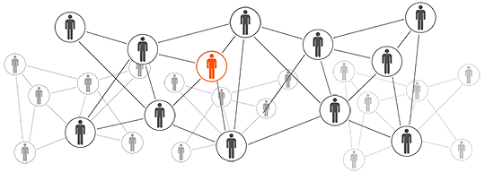

RNS Raw Notification Service
Sy Le Kha
.NET Developer
Lekhasy@outlook.com
Binh Duong University

Slide 2
Contents
What is RNS?
The most proud thing in RNS development.
Demo.
What about social networks?

Slide 3
What is RNS?
Raw Notification Service

Slide 4
What is RNS?
RNS is a solution which provide an efficient way for storing and sending notifications to windows 10 devices.
In fact, RNS delivery a byte array to windows 10 devices.
Notes:
Microsoft notification hub

Slide 5


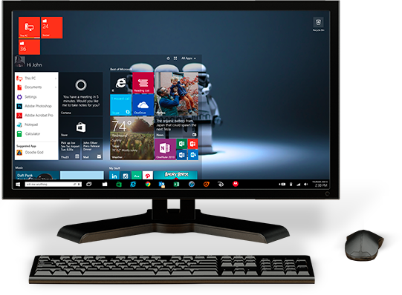
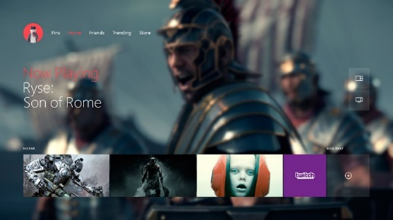
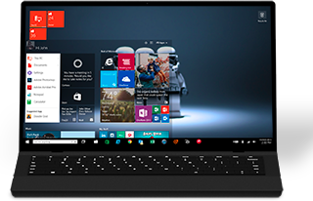
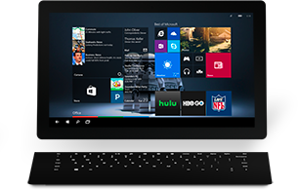
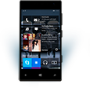

ONE WINDOWS
Phone
Tablet
Classic Laptop
Desktops & All-in-Ones
Xbox

Slide 6
RNS is more than just a service
AES
Windows 10 App
RNS Server
RNS Client
Micorsoft WNS

Slide 7

RNS reliability
We do not guarantee anything in notification delivery.
Send sensitive information via RNS is a bad idea.

Slide 8
The most proud thing in RNS development
Raw Notification Service

Slide 9
Architecture and technologies mistakes
Architecture/ Design mistakes:
RNS has been re-designed 4 times
RNS have only 2 layers => n layers (22 projects)
Technology mistakes:
Low level TCP-IP socket =>WCF service
Linq2SQL => Dapper Dot Net

Slide 10
Demo
Raw Notification Service

Slide 11
But, what about social networks?
Raw Notification Service

Slide 12



RNS
Dynamic receiver group
Easy to control receiver list
One account
Send anything
Have the ability to integrate with other systems (AES)

Slide 13
Can my system use RNS to send notifications to my users?

Slide 14
Thanks for your attention
Sy Le Kha
.NET Developer
If you want to be a RNS contributor, reach me at: Lekhasy@outlook.com
Binh Duong University

